Slide 1
Modflow Practicals 3 and 4

Slide 2
Admin
The optional python modules now taking place after January
I’ll try run something like 2 x 2 hour sessions
Aim is exposure -> not teaching you how to use stuff
Issues on the homework
The next two week - assessed work

Slide 3
Adding to last weeks model – making it more realistic
3D geometries
Mix of confined and unconfined layers
Varying resolution
Varying domain size
Particle tracking and timing
‘Faux’ contaminant transport – lecture last Friday

Slide 4
Brief Jupyter-Python lesson cool tips
How to code –95% copy, paste and modify existing – stackoverflow. 5% custom solutions – my problem for this practical – live demo
How to download as a python file and run as a python script - PyCharm

Slide 5
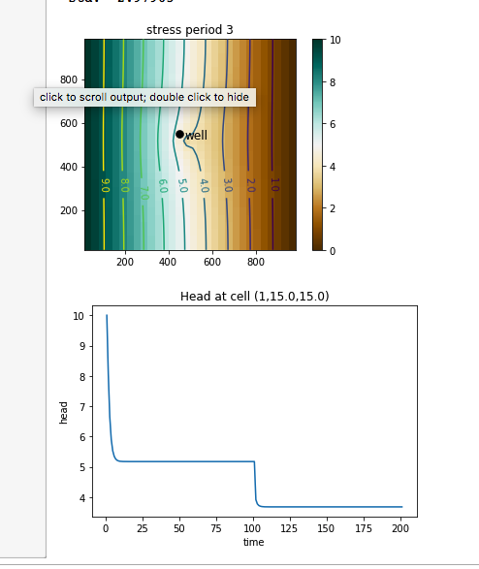
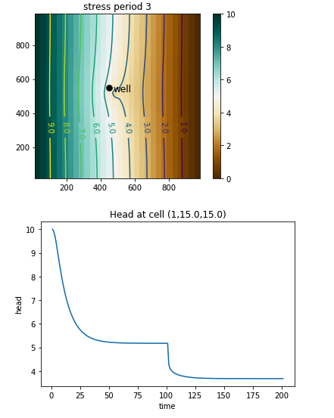
Answers to last week: Ss
Waters is release by compression of aquifer/expansion of water
Volumes are small
Typical 10e-5 to 10e-3
Effects the reponse time not time to reach steady state – but not form of curve
Specific storage is more relevant for confined aquifers

Slide 6
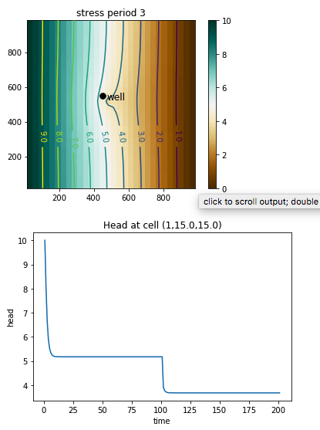
Answers to last week: Ss Varying Sy has no effect with these parameter values
Water drained from within developing cone of depression
Important in unconfined aquifers
Sy cannot exceed porosity
Varies here 0.3 to 0.03
Minor (v minor) difference to time to steady state (higher Sy gives slower development of cone of depression

Slide 7
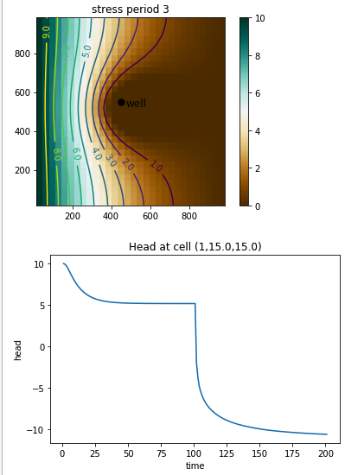
Answers to last week: Hydraulic Conductivity (K)
10 x lower Kv and Kh
Less permeable system – slower to reach steady state
Steady state drawdown is much greater for lower K – remember to look at ABSOLUTE values on y axis

Slide 8
General Lessons!
Formulate a hypothesis – what do you EXPECT to happen – from first principles – direction of change, nature of relatioship (linear? Log-normal? Log-log?)
Research sensible range of parameter values to test eg if K varies over many orders of magnitude then test this range of values!
Run sensitivity tests – check results carefully (note scale changes on axes automatically to bracket results) and check BOTH response time and steady state condition
Compare results of sensitivity test to hypothesis
Be aware that parameters interact – changing one parameter may have little effect at low K but a large effect at high K

